Slide 1
Capstone Project
HeroVired – Group 4

Slide 2
Index
Data Understanding and feature creation
Data Quality and checks
Variable profiling and checking relationships between variables
Modelling and insights
Model Finalized
Important Predictors

Slide 3
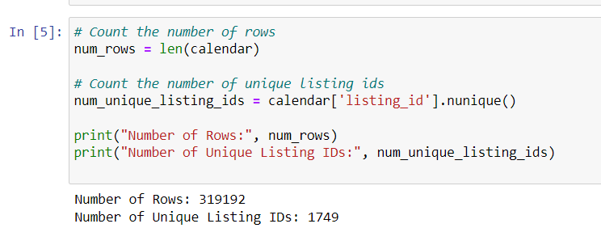
Data Understanding and feature creation
High Activity: The large number of rows suggests high activity on the platform, with listings being frequently updated or changed over time. This could indicate a dynamic marketplace with a lot of user engagement.
Diverse Listings: Having 1,749 unique listing IDs indicates a diverse range of properties available for rent in Antwerp, Belgium. It suggests a variety of options for tourists, which could attract more users to the platform.
Price Column Analysis:
Count: There are 319,117 non-null values in the price column.
Mean: The mean price is approximately $109.92.
Standard deviation: The standard deviation of prices is quite high, indicating a wide variability in prices.
Minimum and Maximum: Prices range from $13 to $5800, with a significant difference between the minimum and maximum values.
Quartiles: The median price (50th percentile) is $79, and the 25th and 75th percentiles are $59 and $115, respectively.
Replaced null values with Median as std is greater than mean.

Slide 4
Data Quality and checks
Checking for Null Values
Checking for Duplicate Values
Checking for Outliers in the data
Data imputation

Slide 5
Variable profiling and checking relationships between variables
Plotting Bivariate relationships

Slide 6
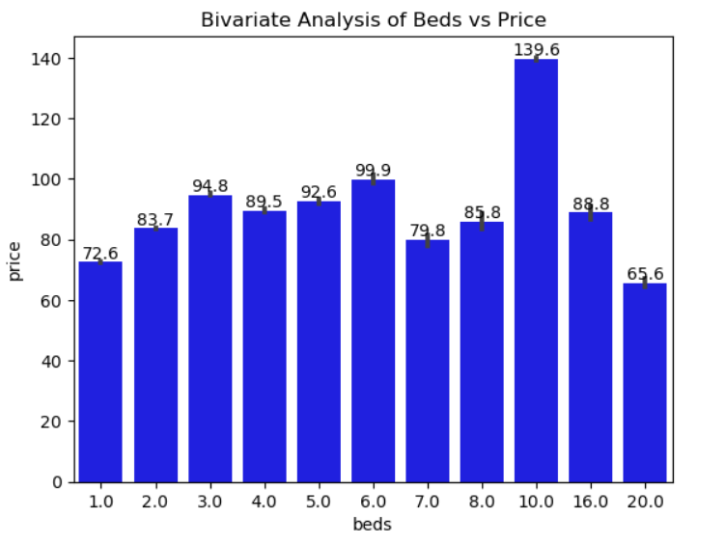
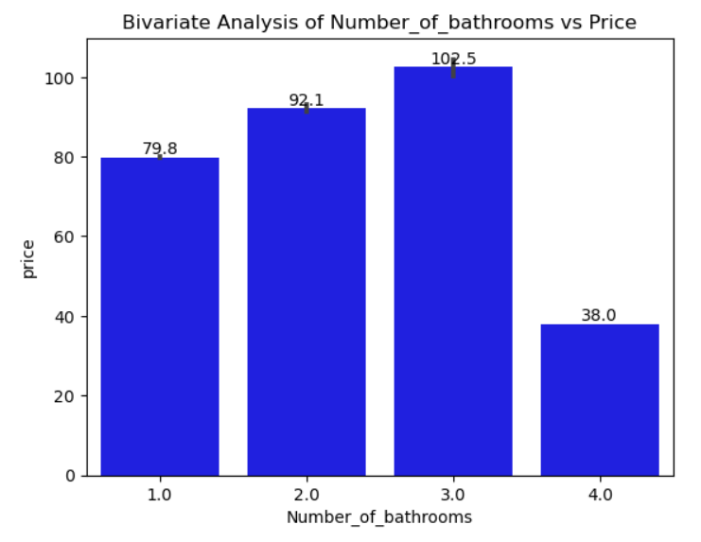
Bivariate Relationships

Slide 7
Modelling and insights
We have split the data as below
  70% train, 30% test
  60% train, 40% validation
Models Used
  Linear Regression
  Decision Trees Regression
  Random forest
  Gradient Boosting Method

Slide 8
Model Finalized
Model | R2 | MSE
Linear Regression | 0.0065 | 1279.04
Regression Trees | 0.9992 | 0.3859
Random Forest Regressor | 0.9995 | 0.39118
Gradient Boosting Method | 0.9987 | 1.6282
Regression Trees seems to be the best suited model as test MSE is better than the other three models.

Slide 9
Important Predictors
Top 5 Important Predictors
Bedrooms
Accommodation Capacity
Bed Count
Amenities
Availability

